Slide 1
Blackmore Partners, Inc.
Social Media Team
May 2017
By Manchit Malhan and Alex Philipose

Slide 2
Understand the starting point …
…to get to your desired end point.

Slide 3
Introduction to Social Media tasks
Daily tasks
LinkedIn Account
Pepdigest
Hootsuite
Nurture Campaign/Infusionsoft
Job updates on Recruiter
Deal Flow Management
Mandate Account/ Nurture Campaign
Deal Qualifying form
BlackmoreConnects™
BMC webinars
BMC marketing
BMC posts

Slide 4
Purpose
Focal Point
How does the social media team supports the BMP process?
How social media team and related tasks impact the cross functional teams?
CRM team
Back end
BlackmoreConnects™

Slide 5
Technology helps Human Relationships
Social media team daily tasks
Deal Flow
Blackmore Partners, BMC and Talent Acquisition
Executive Database
BMC Conferences
Notes:
BELOW there are the three full stories for the 3 worlds → 1) Brave new world, 2) HER World & 3) Black Mirror World
A Brave New World Story:
Government Rules Technology Movement and People Have Strong Dependencies on Technology:
In this world, government regulation determines how advanced technology can develop and to what degree technology is being used in businesses. Technology replaces some human relationships, influencing how people communicate and interact.
In an effort to increase competition and further innovation to stimulate the economy driven by a desire to increase productivity, the government has introduced business and technology-friendly regulatory reform that has decreased the barriers for development of new, improved products and service processes. In this world, investments in artificial intelligence, machine learning and robotics has allowed new technology services to flourish, introducing new ways for humans to seek and get business guidance.
Innovation-friendly regulatory reforms - such as encouraging private sector R&D through tax credits, investment in SMEs, education and training - has encouraged firms to increase efforts in order to explore new ways of increasing productivity and efficiency. The development of digital technology and other advances has revolutionized some sectors. Specifically, the advancement of AI, machine learning and robotics has enabled machines to perform some services more efficiently than humans. Thus, technology has blurred the boundaries between the services consultants provide and what a firm with AI technology can provide for themselves. In 2035, new technology (AI & Robotics) has effectively been integrated into both government and private-sector activities, which has lead to the emergence of a “de facto” standard for the consulting industry, where technology has replaced some human relationships.
In 2016 businesses turned to consultants to help diagnose problems and suggest solutions. In today’s world, many businesses have invested in internal AI technology to analyse and find patterns in data, and ultimately to diagnose problems and suggest solutions to improve business outcomes for themselves. Some industries have become undermined by technological developments, which has caused the displacement of jobs. For example, in the legal and consulting industry, AI has replaced the need for associates. However, in order to counteract displacement, government has developed training programs, such as TechHire in the U.S. which prepares the workforce with the skills to get ahead in today’s and tomorrow’s economy. In this world Government is constantly developing different policies that simultaneously promotes the establishment of technology and human roles in society. Government is controlling the pace and to which extent innovation is taking place.
However, not every facet of the business structures have been automated and there is still demand for human-to-human client engagement and top level management, who can make decision based on human factors (e.g. empathy). This is particularly relevant to the consulting industry, who have adapted to the impact of technology advancements on the professional services environment. Consultants have rebuilt organisations around asset-based or technology-driven intellectual property, using data analytics to provide specialised solutions and services for clients.
2) “HER” World Story:
Detail Description of the World
In 2035, we enter the world of HER, where human seek and get business guidance from robotic machines and not by human consultants. Robotic technology, Artificial Intelligence and Predictive Analytics are well developed to the stage where it can not only answer simple questions but also have an intellectual and humanistic conversation. It not only can provide concrete and accurate data/ information to answer factual questions but also could communicate as well as a professional human consultant can deliver. The development of this technology excellence is fully driven by the private sector, large technology and startups.
The global economy will influence business leaders and managers in terms of the number of projects, and project budgets they can spend on hiring consulting firms and teams. When good economic times, there will be more projects for consulting firms. In this world, we assume technology has developed to the stage where it is cheaper to hire a robotic consultant than a human consultant and it is widely available; thus the majority of clients would rather hire a robotic consultant and it will be easier to hire them.
The global politics and governmental policies in this world fully supports and are open to technology development thus would encourage more robotic consultants to be available for the business world. Some governments will hire robotic consultants for political and economic development projects. The legal system in this world also promotes more usage of robotic consultants since due to capability of the advanced technology- robotic consultants could search more data, be more objective, and providing more accurate suggestions for businesses.
The societal attitude towards having robots in both daily and work life is acceptive, the interaction with technology has developed to the stage where people trust robots and do creates connections with them. Robots are created to provide accurate information as well as humanistic aspects- they could speak different languages and are aware of culture etiquettes.
3) The Story Behind the “Black Mirror” World:
Technological trends, in industries such as virtual reality and hologram creation, have redefined human interaction in a similar way to what Facebook’s emergence meant to the world. With Facebook, a whole new set of social rules emerged that applied to the new “online world” but that at the same time redefined the physical social experiences. This redefinition in human interaction, due to advance in virtual reality technologies, has affected a broad spectrum of business enterprises, comprising the television industry, education, tv shows, entertainment, marketing, and consulting; among others. Ubiquity, the ability to be in more than one part at the same time though virtual devices, is now as established as the Facebook profile was in 2016.
It is 2035 and advisory services have been impacted by technology advancements in both positive and negative ways. On one hand, fixed cost related to infrastructure have severely decreased, and variable costs have also decreased due to less travel hours, the new technologies have sprouted the appearance of boutique global firms that at very low costs deliver MBA level consulting. The industry has been completely redefined, companies manage a higher volume of client meeting on a regular day through virtual avatars and competition is fierce due to the decrease in entry costs. Here’s how it all happened.
The first companies to implement hologram consulting have mostly disappeared by now because of the reluctance of clients back in the 2010-2020 decade, and the difficulty that the first versions of these technologies had on developing a “trusted advisor” relationship. Nevertheless, as the technology grew widespread in other industries, and as the millennial generation ascended to occupy board member positions, virtual and hologram relations emerged as an industry standard.
This event certainly did not come as a surprise to some major consulting firms. Back in 2016 Deloitte Consulting had already predicted the emergence of Virtual Reality as a major industry. To be fair, back in the day Deloitte predicted virtual reality as a major game changer in the home entertainment industry, and they were right during various years. Eventually, service industries migrated to virtual reality and hologram, like live streaming shows, staging massive medical missions with doctors that would be thousand of miles away from the patient, and still have a personal touch in the interaction. Eventually, the first boutique virtual reality consulting firms emerged out of Cambridge, Massachusetts, in Pasadena, California. One of these, caught the eye Deloitte, a firm whose analysts had constantly followed the industry trends, and was rapidly bought and shut down into an in house incubator to decipher how to best apply these new technologies.
In the meanwhile, other traditional consulting companies were reluctant about the emergence of virtual reality consulting. They were confident about the industry known paradigm of trust being built through personalized relationship building. But, as many other industries worldwide, technology was set to disrupt them too. The first hints came from the leaking of the “Caiman Island Records”, back in 2029, which showed how an absurd amount of shallow management consulting firms operated from the island.
After deep investigations authorities realized that a wage of medium and senior managers from elite consulting firms worldwide had left their former employers and formed empty organizations in tropical heavens with unscrupulous tax laws. Taking with them a dense pool of clients this new firms only fixed operating costs were a suitable and secure internet connection and the technology necessary to either project their hologram or have a virtual reality meeting (preferences varied and some companies even used both, utilizing hologram mostly for final deck presentations). The revenues of this shale companies were in the billions annually, and the worst part was that most of their operations were actually in a legal limbo allowing a considerable amount of them to continue operating. Basically, they provided in person consulting in any time of the world, while operating from the cheapest possible locations.
A few years later major consulting firms already had fully established their virtual and holographic IT departments. Deloitte had surprised the market by patenting softwares and security systems that enhanced their consulting services. Their staff in major New York and London offices was moved to more suitable less expensive locations and they designed an onboarding program with most of their clients, teaching them the process of virtual consulting. The other major consulting firms were caught off guard by Deloittes move, the company could now afford to give clients personalized communications at a higher volume on a daily basis. Major consulting firms like McKinsey and Bain began their own virtual consulting division promptly after Deloitte’s first quarterly earning release of the virtual reality revenue.

Slide 6
Process
Notes:
NOTES & Research for the HER World:
Includes → timeline, 5 forces analysis, summary & detailed description of options
HER- World
High Concept:
Robotic Consultants Replace Human Consultants:
A laissez faire and open approach to regulation has allowed intellectual technology (robotics, A.I., predictive analytics) to flourish. In this world, technology services have the capability to replace the need for human to human relationships.
How we get there through the capabilities of the Technology?
2016 (Now)
Nowadays, the ability of machines are limited in terms of problem solving questions for businesses. Current technology can inform users about the weather or the fact based information that eliminates the need of manually “google” online. Robots don’t exist in our daily life yet but we have first generation of robots (IOT) such as Siri, Amazon Echo or iHome. These robotic machines provide us to some limited informations through online search and voice recognition technical capabilities. Even these informations can make human’s life easier but have not yet penetrate nor being used by businesses. In business operations, technology provides capabilities such as conference call via skype or smart phones, for virtual communication. Humans try to catch up this speed by improving their skills to prevent being replaced by machines, rather to manage machines.
Now robots are used in the industry to serve and assist people with core jobs in different industries.Smart robots are already triggering retail innovation. For instance, if you hold a random screw in front of OSHbot, the multilingual robot at Lowe’s Orchard Supply Hardware, it will scan the item and lead you to the aisle that has it. At Hointer, a Seattle-based apparel store, robots deliver
selected clothes directly to the fitting rooms.
http://www.tcs.com/resources/white_papers/Pages/Robotics-as-Service.aspx
Links: To Siri, With Love http://www.nytimes.com/2014/10/19/fashion/how-apples-siri-became-one-autistic-boys-bff.html?_r=0
2020: AI can predict future business landscape by analyzing data collected for different industries and knowledge areas to provide more accurate insights and recommendations than consultants efficiently.
2020- Referring to AI robot say, Watson (AI) for generating industry trends based on the big data analytics ability, checking on seasonality in industry, competitors position in industry, anticipating new economical trends which will help solving most of the problems without the need of human.
Links:https://www2.deloitte.com/content/dam/Deloitte/sv/Documents/technology/Tech-Trends-2015.pdf
http://www.gartner.com/newsroom/id/2867917
By 2020, probability of predicting future calamities and epidemics will be more accurate which will help in pre-empting consequences of major losses as damages are as high as $60 billion which will hinder the progress of national economy. Artificial intelligence can help nations to prepare blueprints for curbing damages and changing the need of consultants for different industry scenarios but using robots instead to plan future moves.
Links: http://www.ncbi.nlm.nih.gov/pmc/articles/PMC2725828/
2025: At this point, technology will be very helpful for business life. The cooperation between human and robots will contribute to create a good work- where human will manage robots and robots would provide fast factual research and start to learn humanity from human.
Link : Meet the cobots: humans and robots together on the factory floor
http://www.ft.com/intl/cms/s/2/6d5d609e-02e2-11e6-af1d-c47326021344.html#axzz4BJhtgv5L
2030: Advance robots can replace human touch as they will be more human in nature and will have human emotions, can develop personal relations with clients, empathise with client’s situation while working on client projects leading to increased confidence in them. Now robots can seek and develop human network.
For example: In movie Iron man Tony Stark’s assistant is a robert, helping him and meeting his lab needs.
2035: Robotic consultants is able to provide accurate, fast information along with practical recommendations for clients; and will fully replace human consultants.
In these days, technology will provide us almost everything in every aspect of life. There will be worker robots with personality. Instead of the labor force, everyone will choose to work with robots because their margin of error will be almost zero.
“Oxford University researchers have estimated that 47 percent of U.S. jobs could be automated within the next two decades. And if even half that number is closer to the mark, workers are in for a rude awakening.”
Link: Rise of the Machines: The Future has Lots of Robots, Few Jobs for Humans
http://www.wired.com/brandlab/2015/04/rise-machines-future-lots-robots-jobs-humans
Other Consideration Factors
The ethical and moral aspects may cause different degree of acceptance in different regions of the world. In the more conservative areas of the world and those regions where technology infrastructure isn’t as developed; may be slower in the process of embracing robotic consultants by 2035. The availability of resources to build equally knowledgeable robotic consultants may also different among regions. For some clients, they might have personal reasons in not having robots; we do not know how to estimate how big this population would be, but it is expected to be minimal as our current education across the globe promotes technology.
On the other hand, transition is happening in consulting industry, as now companies are updating the skillset of their workforce by preparing them to handle and manage data generated by machines, complementing the accuracy of future predictions and trend analysis with human brains.
In future, in robotic age as robots can function and perform effectively based on their expertise level designed by humans. Robots cannot replace human brains as they are bi-product of human brain and humans will continue innovating new technologies and dominate the industry irreplaceable.
Clients will be seeking for guidance in regards to Innovation, Transformation type of projects as the world enters an era of robotics. Current human consultants will now transition their role in solving higher level innovation projects in economy
Consulting will be the primary concern of the industry as in the robotic age, economy will reach the point where Humans will need to manage robotic transformation of business activities and develop new strategies to meet the changing demands of the consumers in the economy.
5 Forces Analysis
Power of Suppliers
Ø Suppliers: Technology firms that create, design, and manufacture robots, database management firms
• Pressure is medium because the availability of robotic technologies is common, with few leading firms dominating the market (like an oligopoly)
• The cost is also relatively moderate ( to get basic robots)
Software technology will be changing rapidly in the robotic age hence software suppliers will have high power because of the customized services.
Power of Buyers
Ø Buyers: industry firms, schools, governments in both domestic and international markets
• Pressure is high because consulting services is a “service” base industry; client has the choice of whom to consult for business guidance- different consulting firms, in house consulting departments, or boutique consulting.
• Power from both public and private sectors will spend on such services based on economic and budget
Threat of Substitute
Ø Suppliers: In house consulting unit, self learning tools from home robots
• Pressure is medium because the availability of information existed in house, and could be cheaper for firms
• If technology is so advance, clients could self educate(our their home robots) could self educate to problem solve.
• If in house robots are very advance and can plan different scenario’s 3-5 years ahead , it will help companies to pre-empt the change and this might eliminate the high need of 3rd party consultants.
Threat of Entry
Ø Potential Entrants: New and existing firms with deep knowledge of industry, owns data, and have resources, or the technology robotic design and manufacturing firms.
• Pressure is high because whoever has the technology and resources will be able to enter the industry
• Firms that have a lot of data that could be useful to sell by pairing with consulting services or has special knowledge on niche markets
Intensity of Competition
Ø Competitors: Current consulting firms (ex.Bain & Company, BCG), A.I/Robotic Technology Firms?
• Pressure is high as all players are going after same customer segment, multiple number of strong competitors
• Quality differences is low among majority of competitors
Options:
1- (Core & Satellite) Buy: robot technology
Purchase robots (with A.I capabilities) from the following:
Aldebaran by SoftBank Robots - France-
AvatarMind - China
Honda - Japan
Toyota - Japan
Boston Dynamics - USA
Gostai - France
Bosch - Germany
YuMI by ABB - Switzerland; YuMI has two arms as a human with a vision of robots. YuMI designed to work with human to create endless possibilities.
The cost of a robot is approximately $100,000 to $150,000
2- (Bet) Make : Enter the design, creation and manufacturing of robot consultants and provide consulting services using their own robot consultants.
Phase 1: Invest in R&D, specifically in the design of robots. “Humanoid Robots”
Location: USA, Japan, France, Switzerland
Suggested Team Composition: McKinsey consultants, researchers, and robotic design experts to design the robots that they can provide factual data as well as communicate like a human.
Suggested design, manufacturing partners: Bosch, Toyota, ABB as well as school collaborations (ex. MIT )
Phase 2: Set up a lab and manufacturing plant for making robots
Suggested start point: MIT Media Lab and test the prototypes
Test with internal services first
Phase 3: Use the robot consultants in McKinsey’s consulting services as well as perhaps sell this robot to others (consider competitive landscape)
Fully use the robotic consultants in McKinsey's offices across the globe, start with regions and offices where the market/ client is more acceptive and familiar with using robots.
Modify the robots and sell them to others, for example, healthcare industry (day care robot nurses).
3. Partnership with Robotic Technology Firms and Education Institutions
Phase1- Form a think tank group with academia, government and technology firms to fully understand the potential, capability of having robotic consultants.
Think tank groups to understand transformation in technology and robotic technology
Invest and collaborate in research labs such as MIT robotics and technology.
Phase 2: Partner with robotic company to gain robotic technology and use it in our business operations.
Potential partners are Bosch, Kuka, ABB, IBM
Robotic technology will provide supply chain robotic management, vendor management, employee assistance, routine checks and compliance audits
Needs of A.I such as IBM in consulting industry for cloud computing and robotic design innovation for future
Partner with developing nations such as China and India for renewable technology strategy
Phase 3: Explore opportunities with the next level institutions to utilise robotic technology to “stay in the future innovation loop”
Potential partner with space research institutes such as Nasa, ISRO
Use their cutting edge technology in industry to serve various needs of the changing world.
Design innovations specifically- automobile for example flying cars, real estate for example compact and moving rooms, automated homes and biotechnology for ex replaceable limbs, dna modifications, healthcare sector. All of these alliances are created in order to “Stay on the loop”

Slide 7
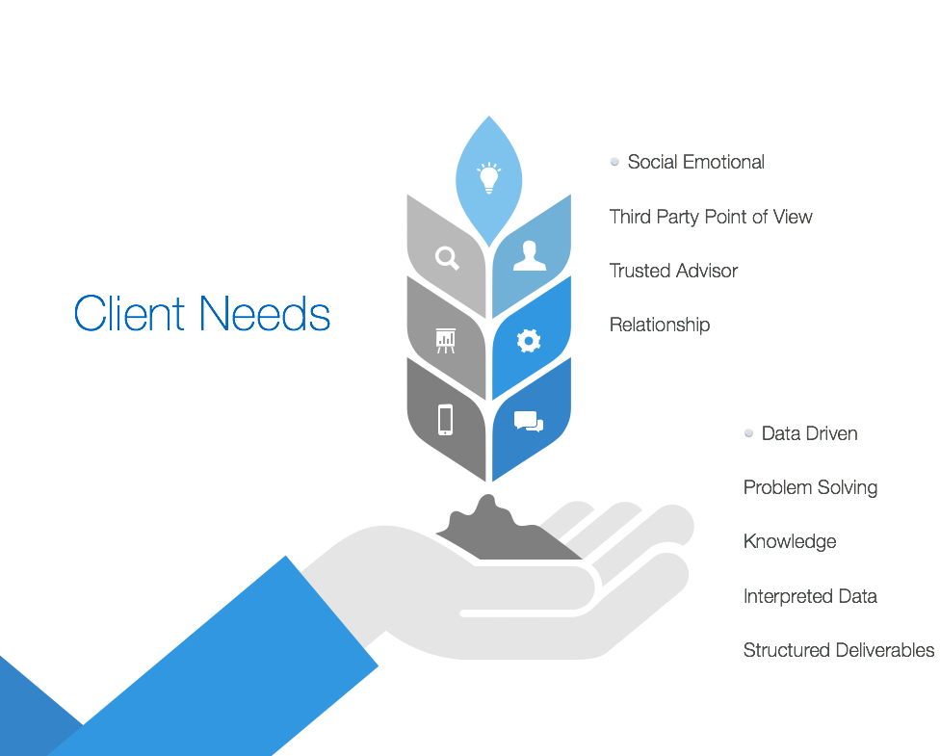

Slide 8
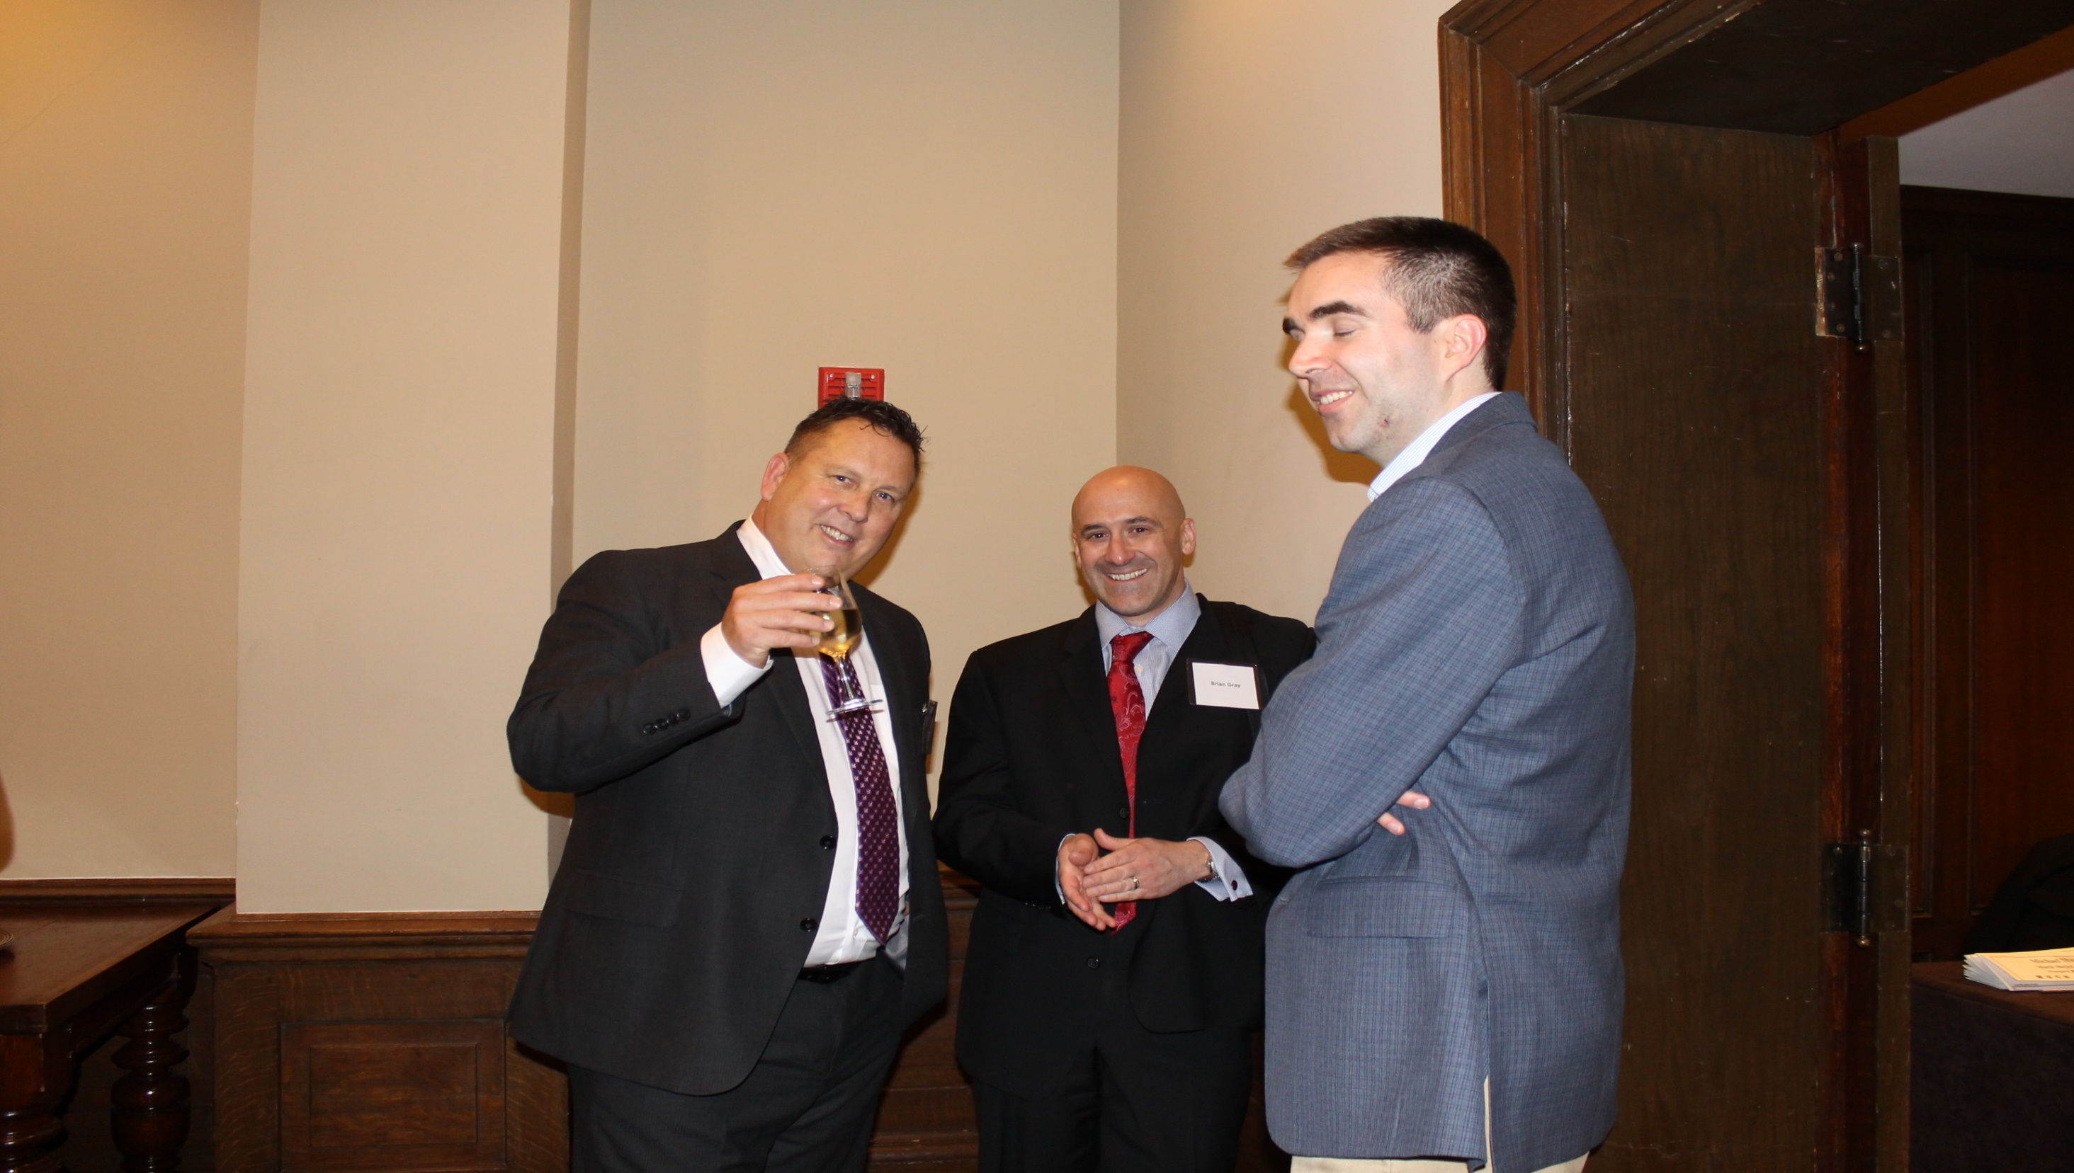
Success

